Slide 1


Criminal Law Data Analysis – Puerto Rico Edition
Donnie Aikins
Presentation I

Slide 2
Mentor
Carlos Paniagua, Salve Regina University
carlos.paniaguamejia@salve.edu
Researcher
Diego Alcala, Defensoría Legal
dalcala@defensorialegal.com

Slide 3
Criminal Law Data Analysis – Puerto Rico Edition
United States District Court of Puerto Rico
  Puerto Rico Association of Criminal Defense Lawyers (compiled documents via PACER System)
Visualizations
  length of time that the case is "open"
  % of persons represented by a court-appointed attorney
  average length of sentences
  etc..

Slide 4


Goals & Timeframe
Project Goals
  Visualization of Dockets & Indictments
  Analysis of trends amongst supreme court reports
Timeframe
  Start Date: 10/01/2021
  End Date: 03/31/2022

Slide 5
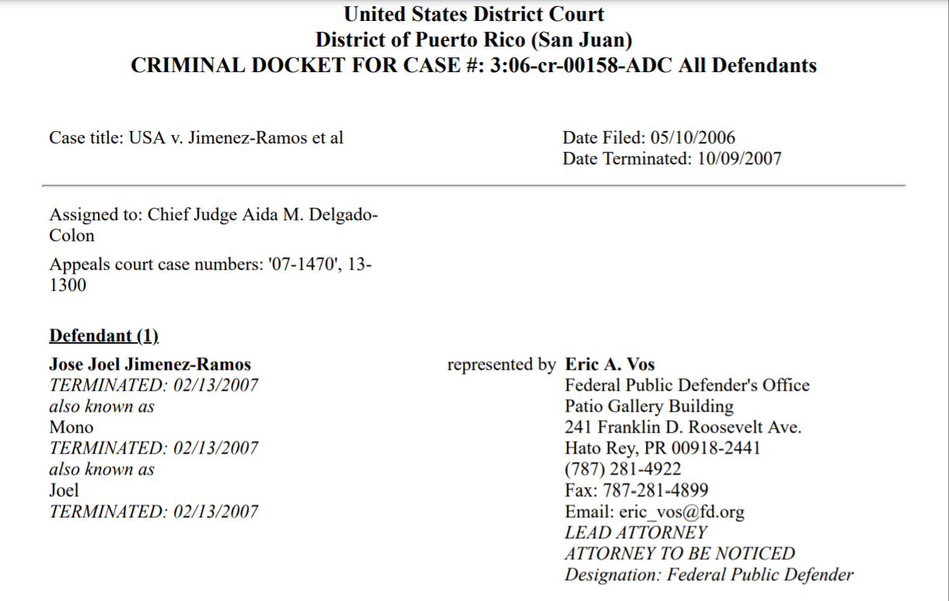
Docket Sheets
Variables of analysis
  Dates [start, end]
  Case Number
  Case Title etc…
Structure of Data
  CSV/XML file

Slide 6
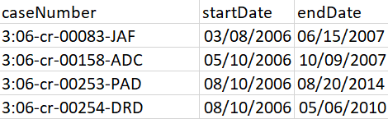
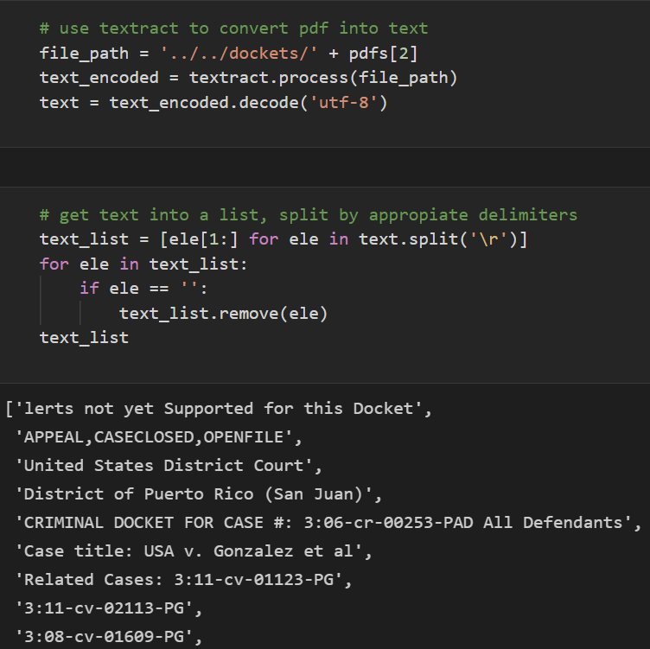


Exploratory Analysis of Length of Cases
Initial Decision
  Extract information from all docket sheets
  Structure into csv file
  Headers: Case Number, Start Date, End Date
Python
  Pandas, Textract, Pyplot etc…
  GitHub

Slide 7
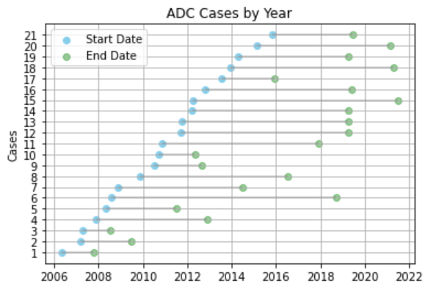
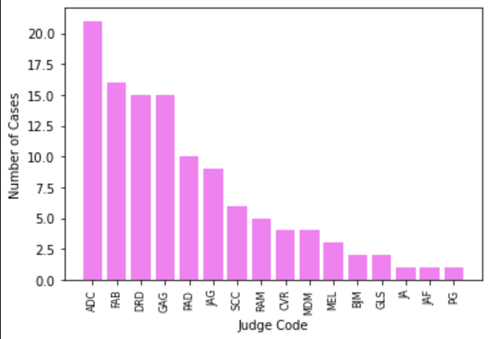
Results
Length of cases per Judge
  Cleveland Dot Plot
    X axis: Year {month included depending on short cases}
    Y axis: Number of cases
Aida M. Delgado Colon had the most cases
  Why? More variable exploration?
Distribution of cases not evenly spread

Slide 8
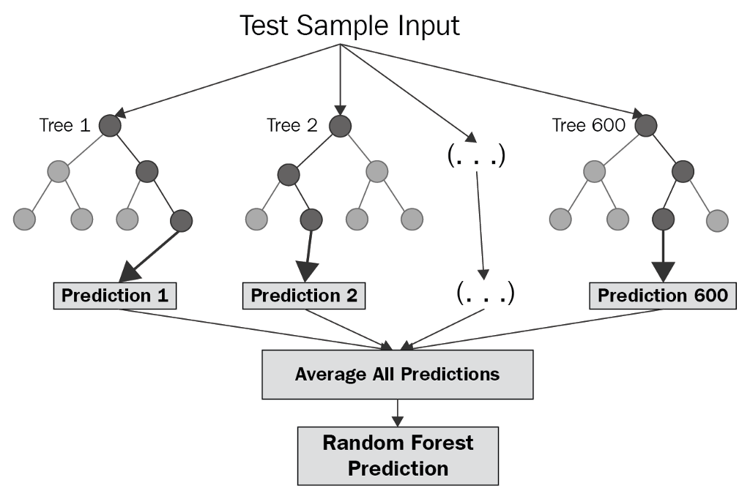

Further Analysis
Goals for Next Month
  More variable analysis
    Judge Code, Defendant & Sentence
  Explore modelling
  Statistical testing
Modelling
  Is Judge X likely to do Y for future cases? Random Forest Model?
Statistical testing
  Chi Squared
  ANOVA

Slide 9
Feedback
Questions?
Suggestions?

