Slide 1
Waveform Systematics for
Black Hole Binary Mergers Models
Student: Samuel Clyne, University of Rhode Island
Samuel.clyne@uri.edu
Mentor: Dr Michael Puerrer, URI
mpuerrer@uri.edu
Date: 11/8/2023

Slide 2
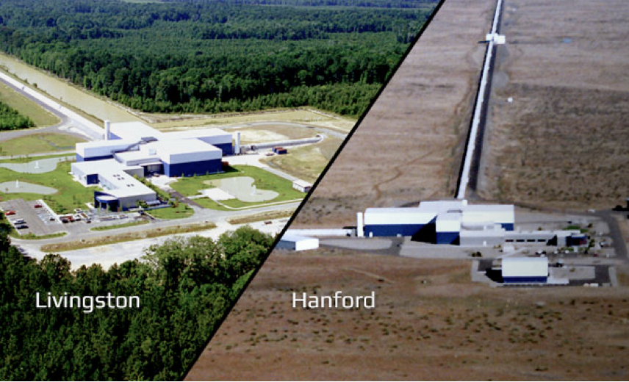
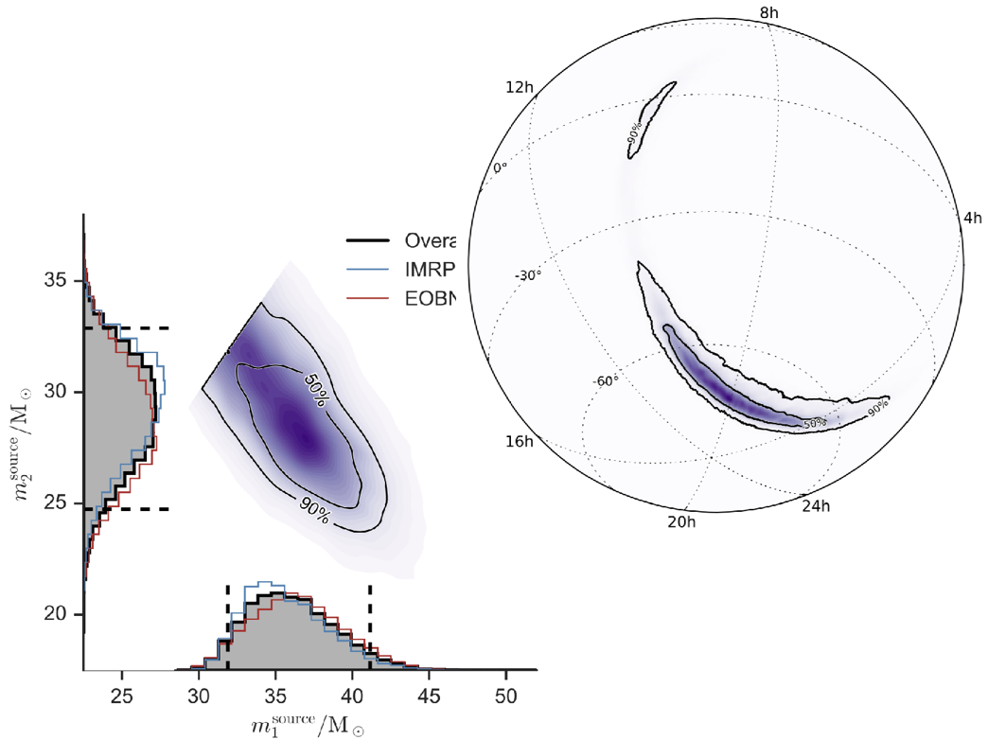
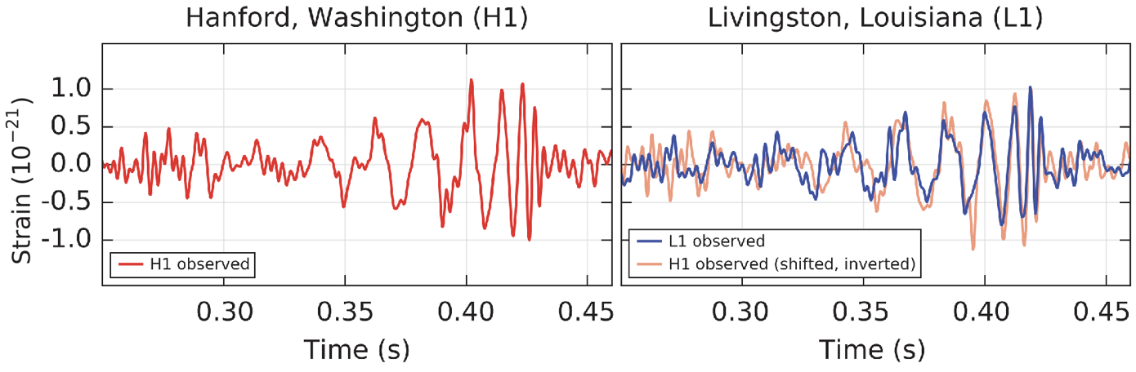
Waveform Systematics for
Black Hole Binary Mergers Models
Black hole mergers can be characterized using gravitational wave data collected at LIGO/Virgo
Deep Inference for Gravitatational-wave observations (DINGO) leverages neural networks to speed up analysis vs traditional methods
LVC, PRL 116, 2016

Slide 3
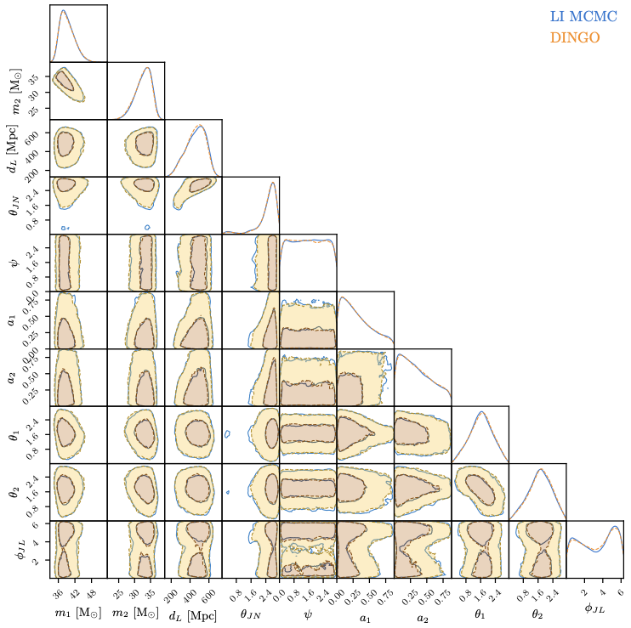
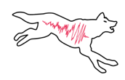
Waveform Systematics for
Black Hole Binary Mergers Models
Train on simulated data (Gaussian noise + GW signal)
Training: ~1 week (NVIDIA A100)
Inference: ~ 1 minute [GPU]; ~ hours with importance sampling [CPU]
Posterior and evidence match with traditional samplers (~ 1 nat)
Code: https://github.com/dingo-gw/dingo

Slide 4
Waveform Systematics for
Black Hole Binary Mergers Models
Imperfections in gravitational waveform models can lead to significant bias in estimating parameters
Study such effects by leveraging the Dingo code to efficiently analyze synthetic GW events for a number of waveform models
Goal: create a visual map of discrepancies between the posteriors for different models to guide model improvements
Start with simple models (spins aligned with orbital angular momentum); then consider models which include higher order modes

Slide 5
Waveform Systematics for
Black Hole Binary Mergers Models
Timeframe
Start Date: October 1, 2023
  End date: March 31, 2024

Slide 6
Waveform Systematics for
Black Hole Binary Mergers Models
What I hope to learn
A deeper understanding of gravitational waveform modeling
How to write efficient scripts that leverage HPC (Unity cluster)

Slide 7
Waveform Systematics for
Black Hole Binary Mergers Models
Goals for Next Month
Run Dingo tutorial models on synthetic data
Train neural networks for simple waveform models and begin inference on synthetic data

