Slide 1
Improving earthquake detection and localization with deep learning
Student: Zhangbao Cheng, University of Rhode Island
chengzhangbao@uri.edu
Mentor: Yang Shen, University of Rhode Island
yshen@uri.edu
Steering Committee Liaison: Gaurav Khanna, University of Rhode Island
gkhanna@uri.edu
2023.11.08

Slide 2
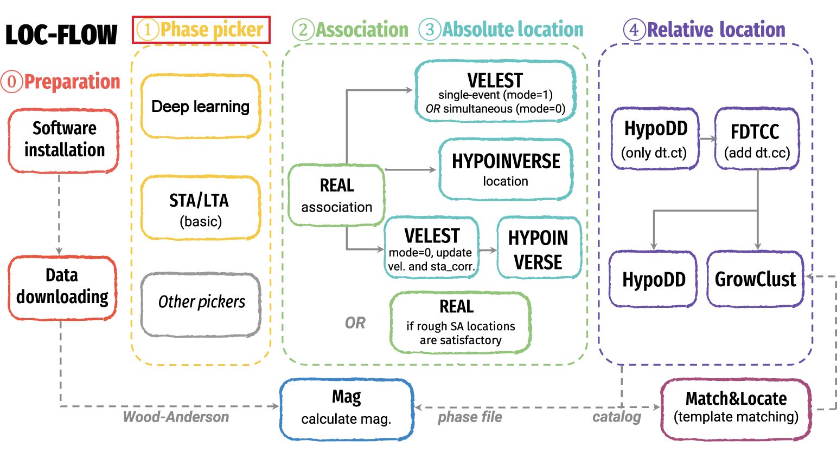
Improving earthquake detection and localization with deep learning
The growing amount of seismic data necessitates efficient and effective methods to monitor earthquakes.
Current methods are computationally expensive, ineffective under noisy environments, or labor intensive.
Typically workflow of earthquake location
Zhang et al., 2022

Slide 3
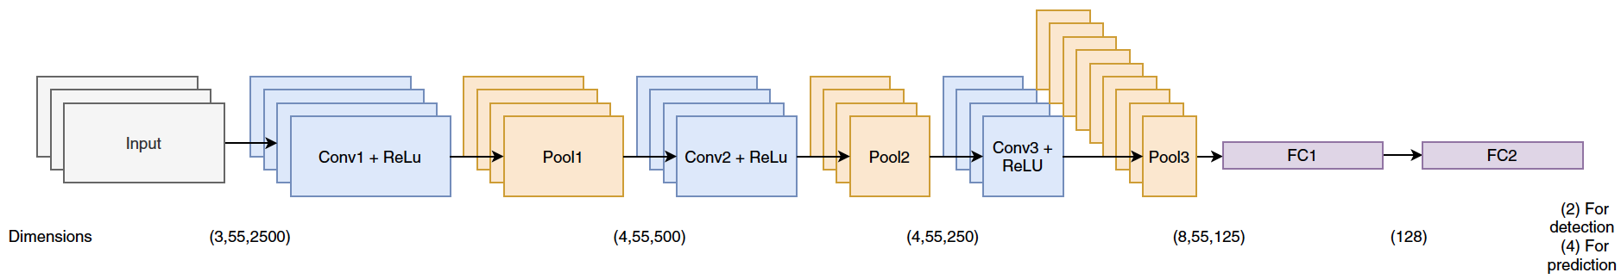
Improving earthquake detection and localization with deep learning
ArrayConvNet—a convolutional neural network model trained by 1843 analyst-reviewed earthquakes and 1905 noise segments recorded by 55 stations from the Island of Hawai‘i
Shen, H., and Y. Shen, 2021
Seamlessly detect and localize events
No intermediate steps of phase detection, association, travel-time calculation, and inversion

Slide 4
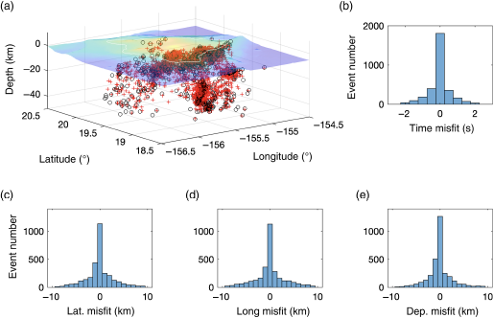
Improving earthquake detection and localization with deep learning
99.4% event detection accuracy
A few kilometers hypocenter location errors
6 times more detected events than published catalog
Shen, H., and Y. Shen, 2021

Slide 5
Improving earthquake detection and localization with deep learning
To further improve the deep learning model:
Include more catalog earthquakes
Use relocated earthquakes with more accurate locations
Apply enhanced data augmentation
We now have a comprehensive high-precision relocated catalog of seismicity for the Island of Hawaii 1986-2018 (Matoza et al., 2020), which includes 275,009 successfully relocated earthquake events.

Slide 6
Improving earthquake detection and localization with deep learning
Goal:
Bring the ArrayConvNet model close to the practical and operational levels by involving large scale training datasets and a huge amount of continuous data
The advanced HPC computational facilities will make it possible

Slide 7
Improving earthquake detection and localization with deep learning
Timeframe:
Start date: 2023.09
End date: 2024.03

Slide 8
Improving earthquake detection and localization with deep learning
What I hope to learn:
Seismic data process and analysis skills
Programming skills (Pytorch, Obspy, Pandas, etc.)
Use of high-performance computing clusters
In-depth understanding of deep learning and neural networks

Slide 9
Improving earthquake detection and localization with deep learning
Goals for Next Month:
Process the original catalog file
Extract earthquake information used in model training and testing
Write seismic data download code

Slide 10
Improving earthquake detection and localization with deep learning
Help needed：
HPC resource access, get started (Andromeda, Unity)

Slide 11
THANK YOU

