Slide 1
Development of personalized healthy food incentives to improve diet and cardiovascular risk
Student: Anthony Francisco, University of Rhode Island
Mentor: Dr. Gaurav Khanna, University of Rhode Island
Researcher: Dr. Maya Vadiveloo, University of Rhode Island

Slide 2
Smartcart
Smartcart is a personalized meal planning app designed to cater to individual dietary preferences, allergies, and nutritional goals, making healthy eating simple and enjoyable.

Slide 3
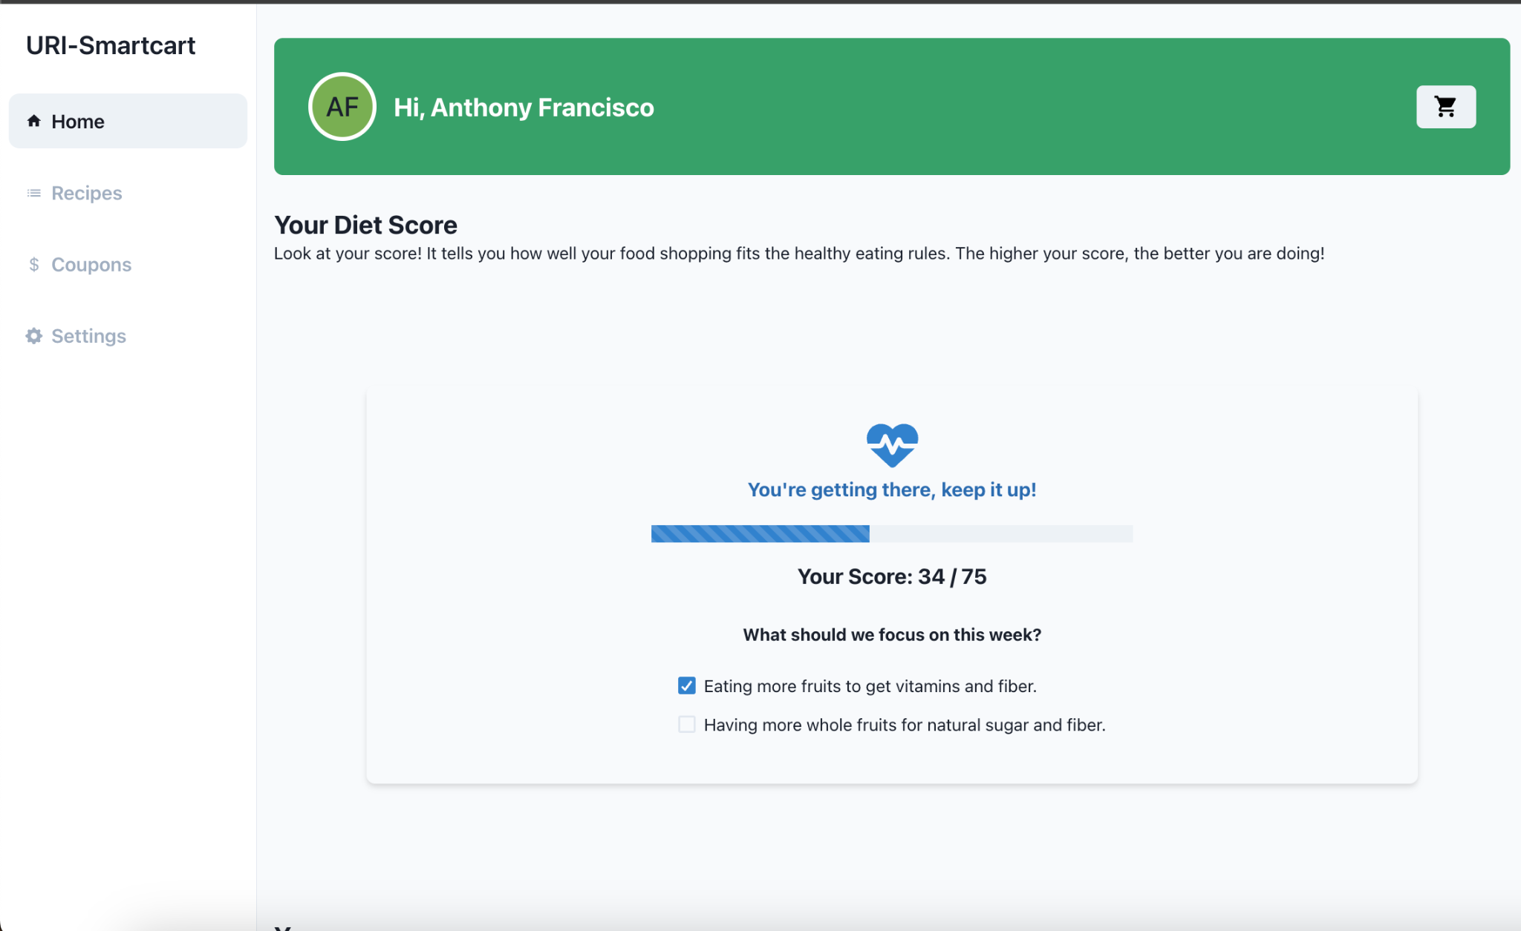
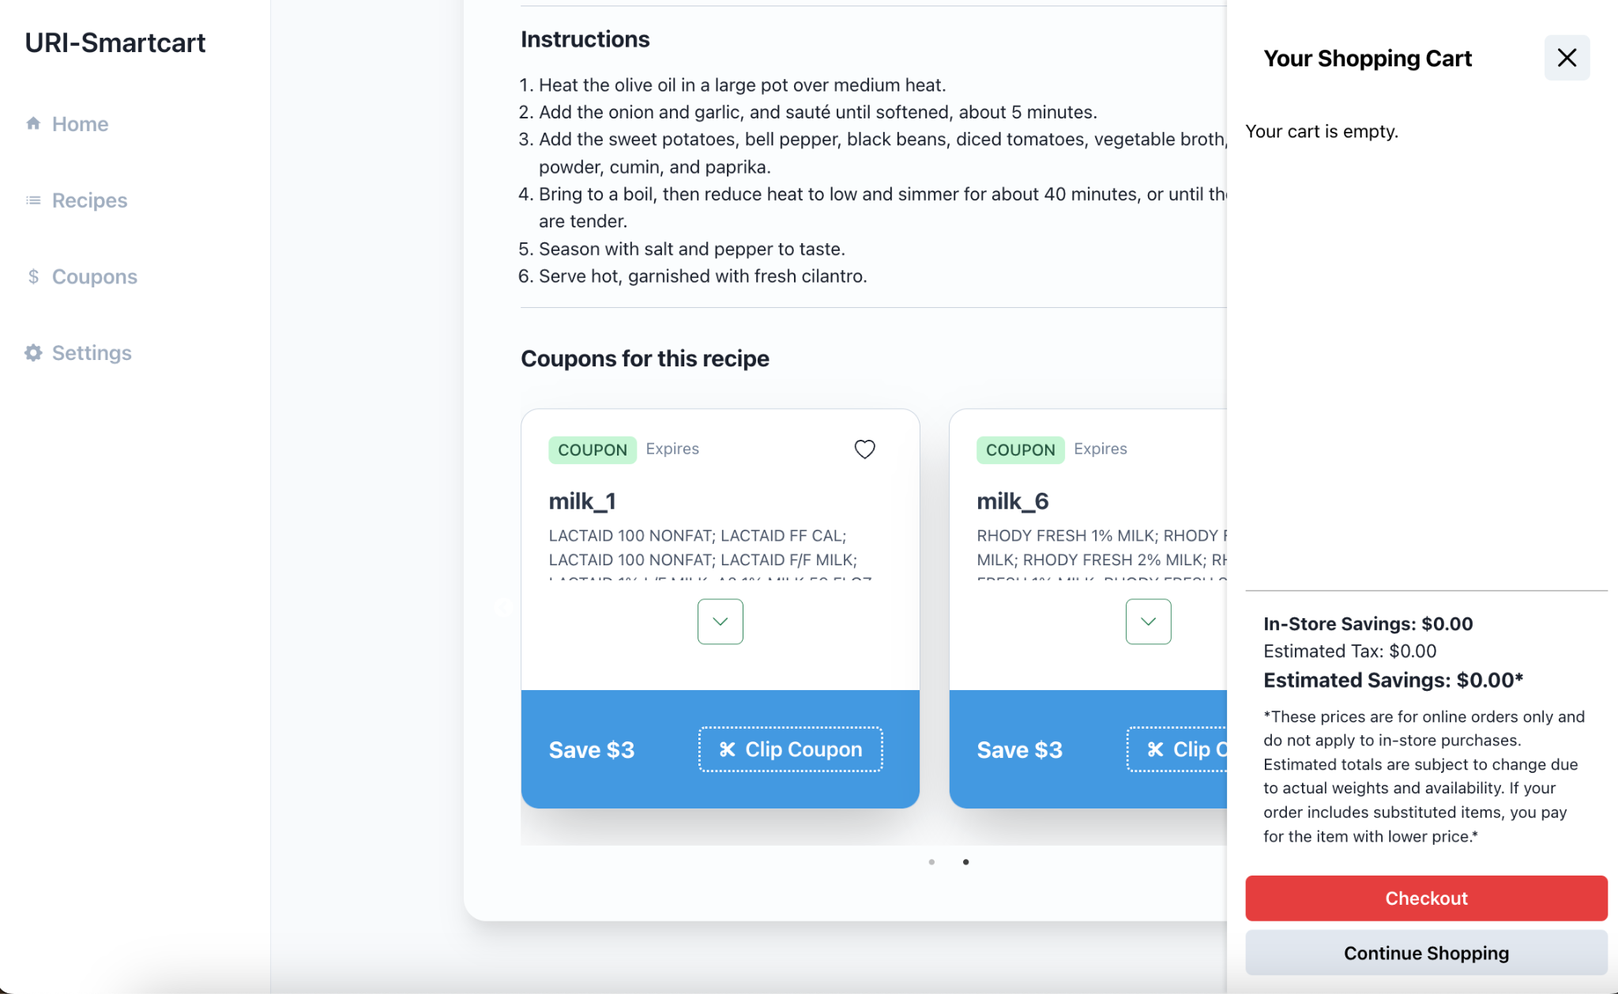

Slide 4
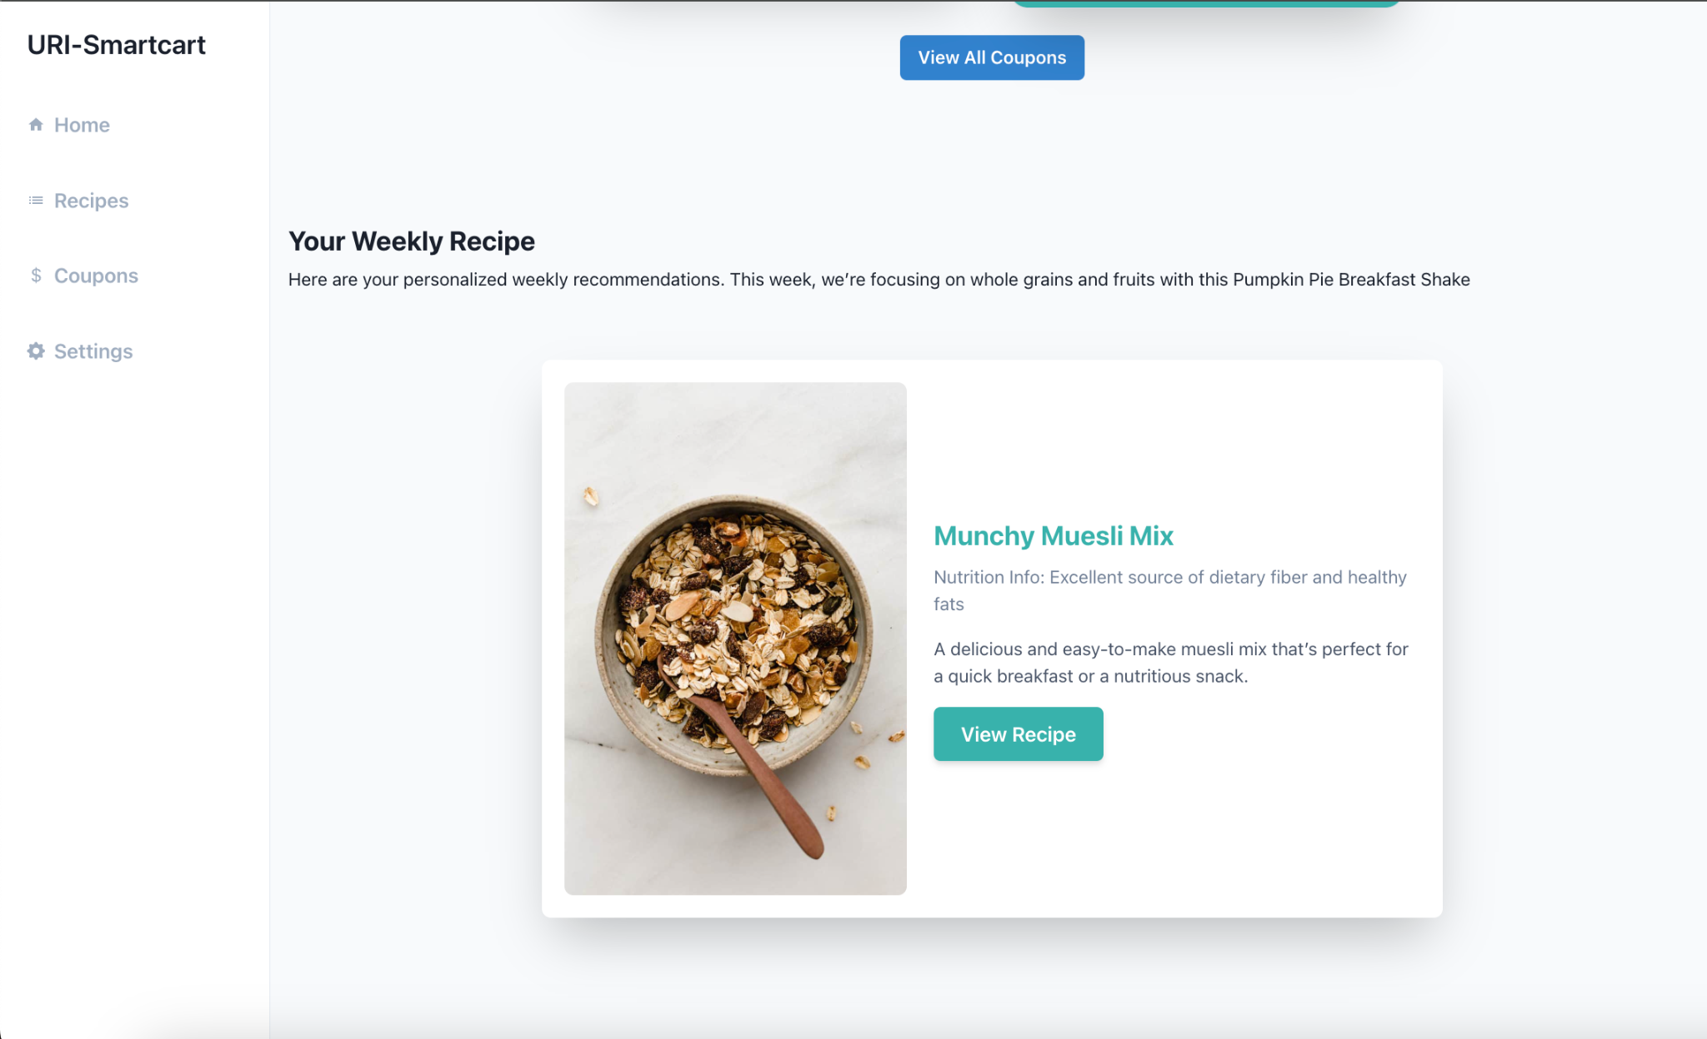

Slide 5
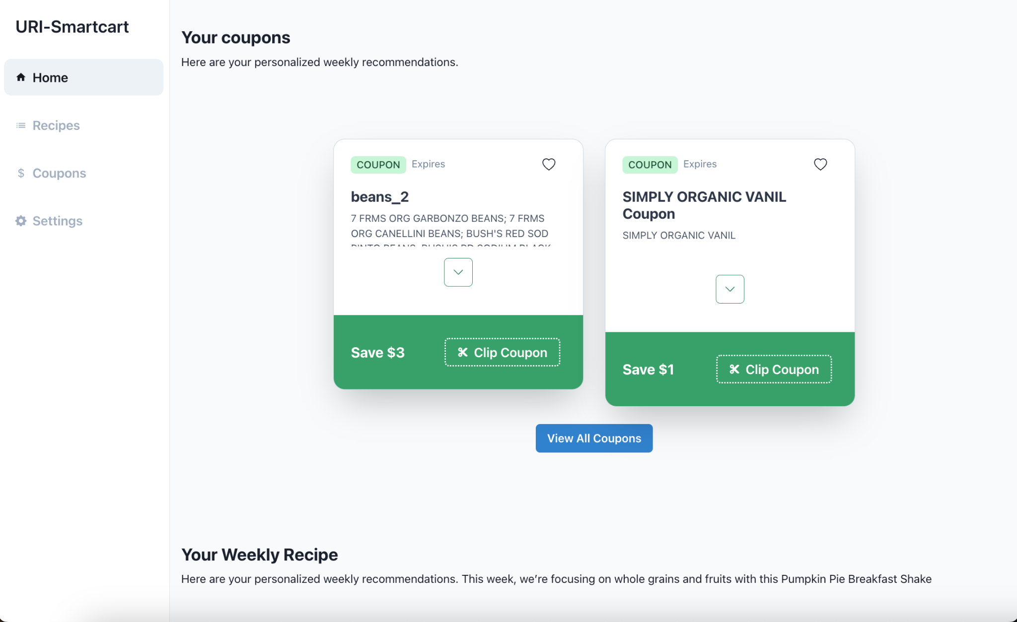

Slide 6
Smartcart
Timeframe
  Oct 2023
  Apr 2023

Slide 7
Smartcart
Updates:
  Back-End: Express Server (MVC)
  Front-End: UI, connects to server
  Database: DynamoDB→MySQL Database
  Algorithms: NLP rec., scripts

Slide 8
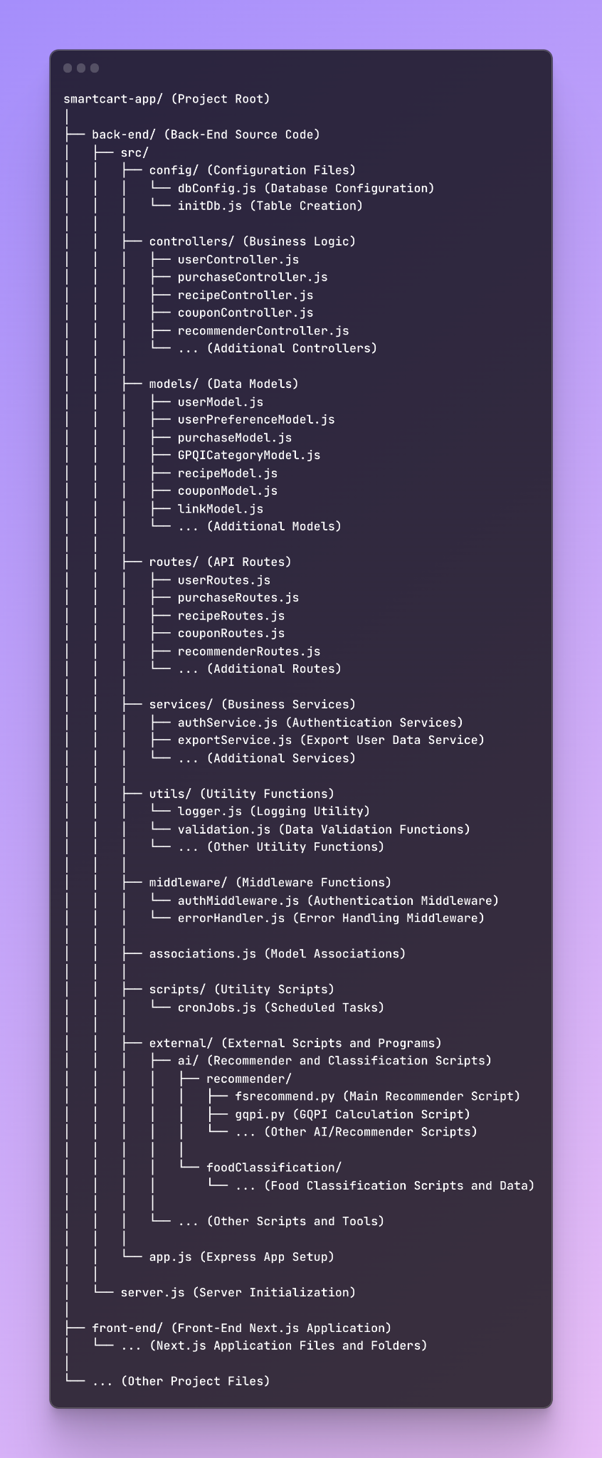
Smartcart

Slide 9
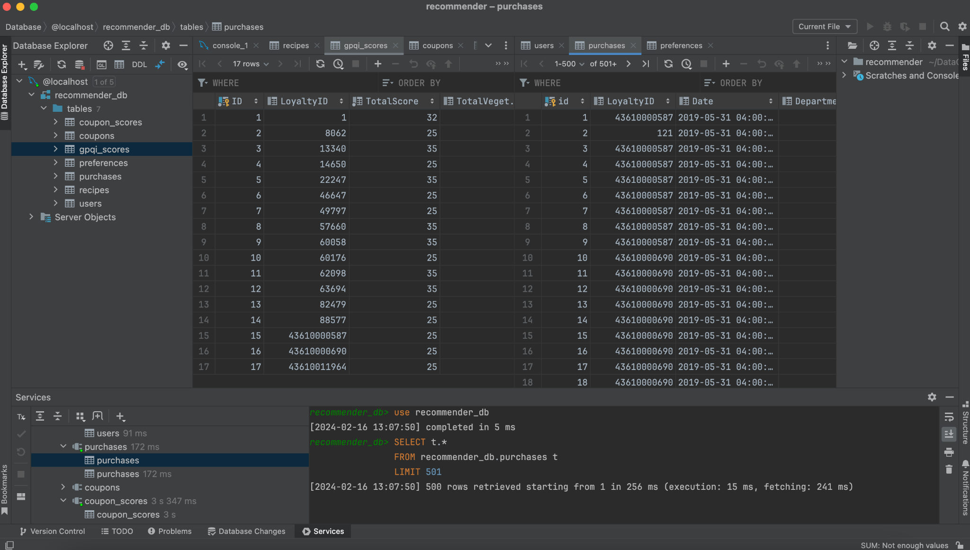
Smartcart

Slide 10
Smartcart
Goals for Next Month
  Deployment: Host on URI server
  UI/UX Refactoring: sous.casa
  Gorilla Shop Builder

Slide 11
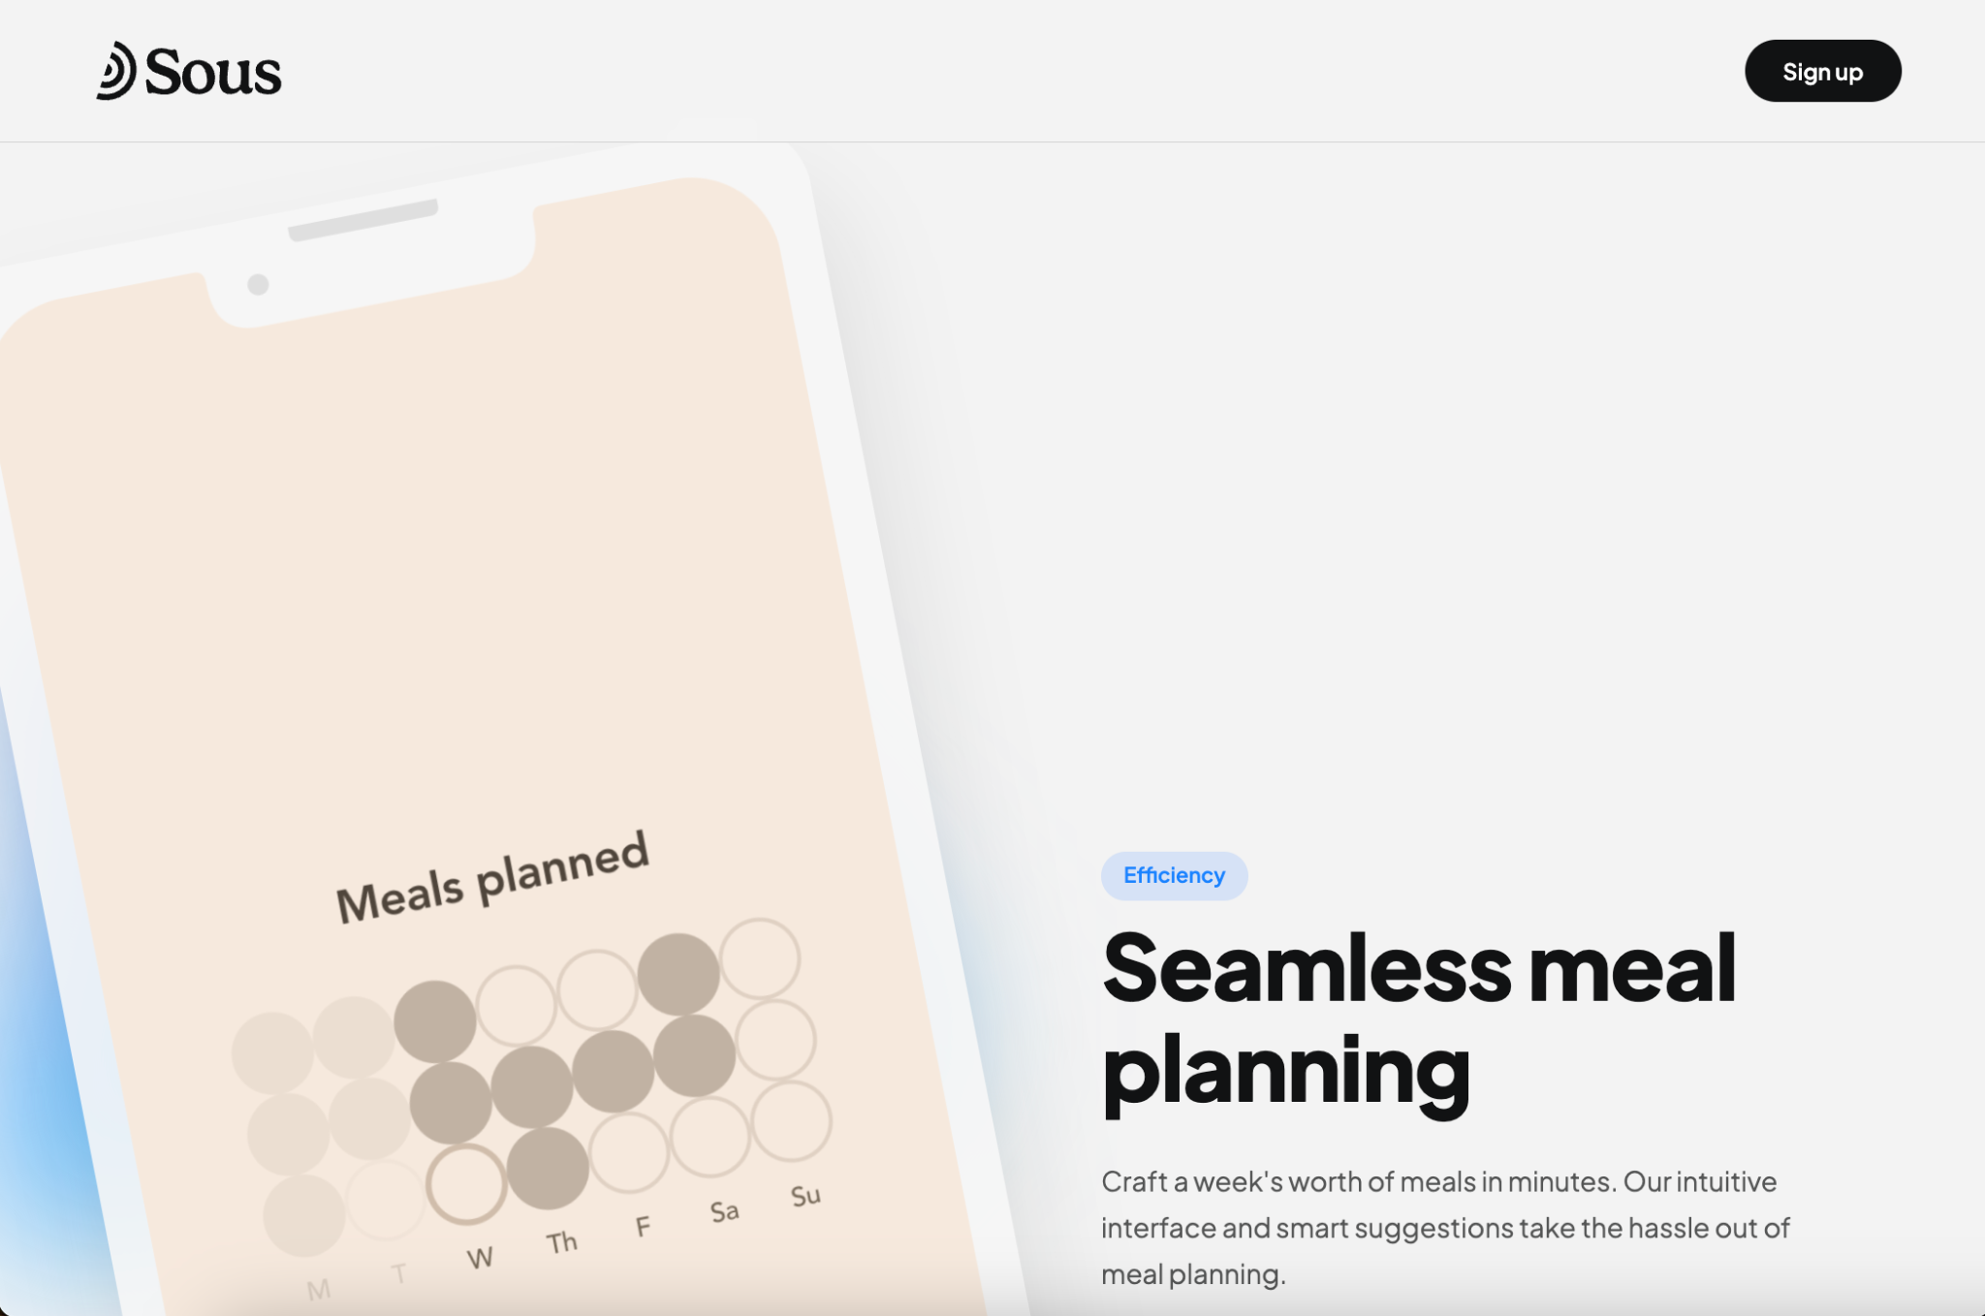
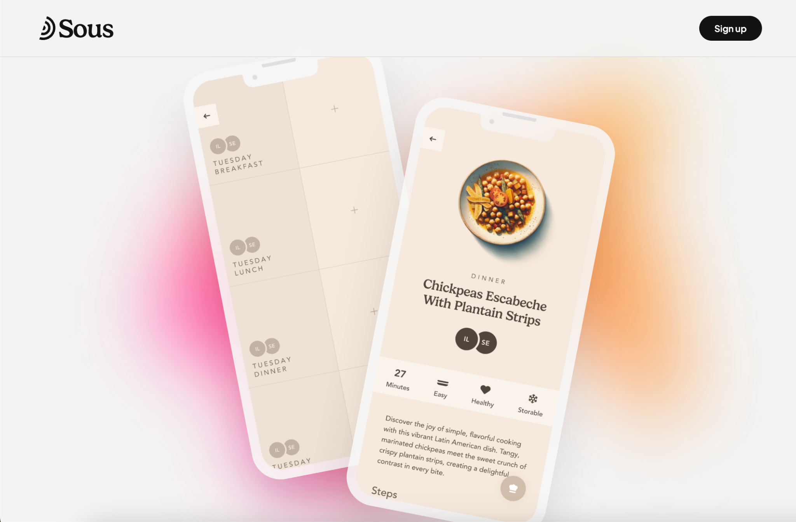
Smartcart

