Slide 1
Optimization of Mouse Social Behavior Data Analyses Pipeline
Student: Joel Turk, University of Delaware
jturk@udel.edu
Mentor: Anita Schwartz, University of Delaware
Researcher: Dr. Josh Neunuebel, Psychological and Brain
Sciences Department, University of Delaware
1/13/21

Slide 2
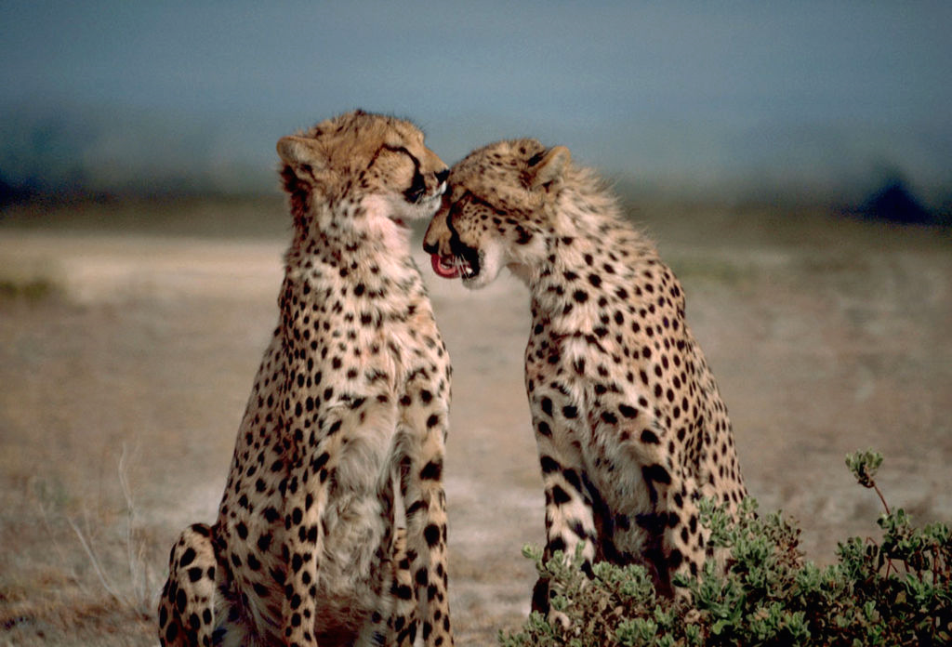
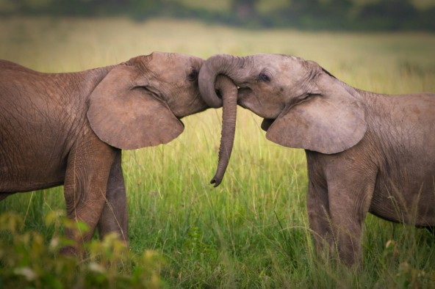
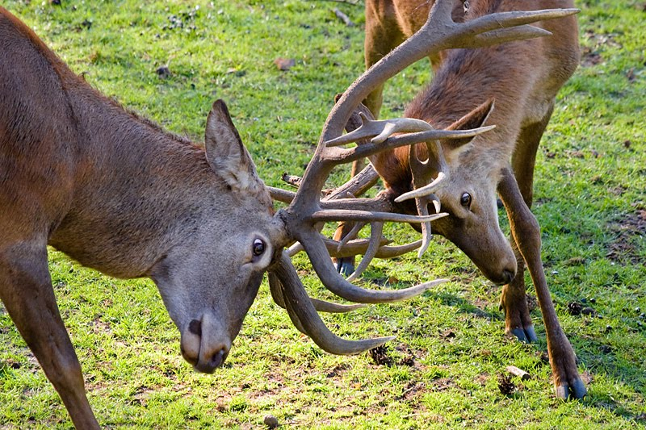
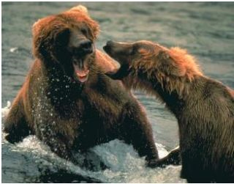
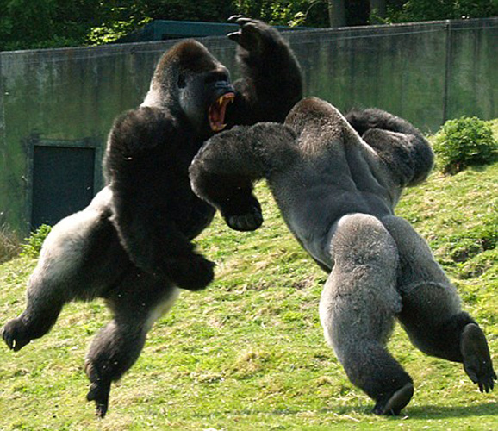
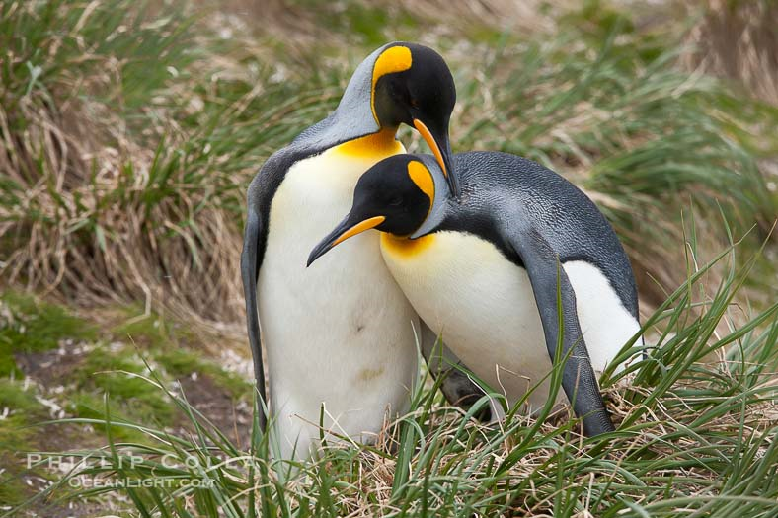
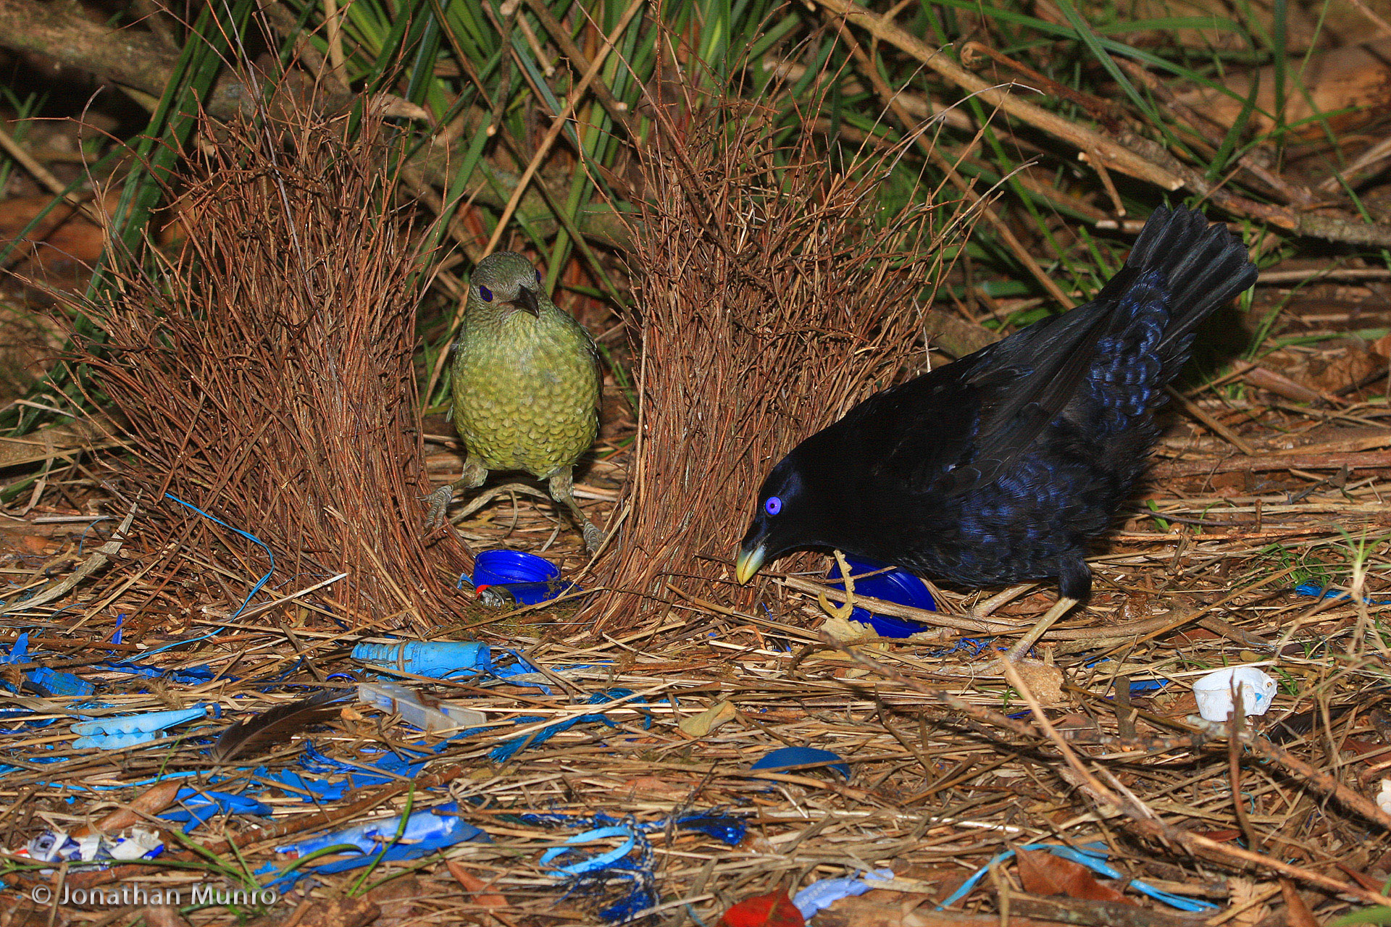
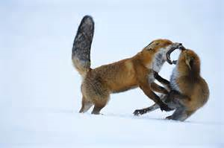
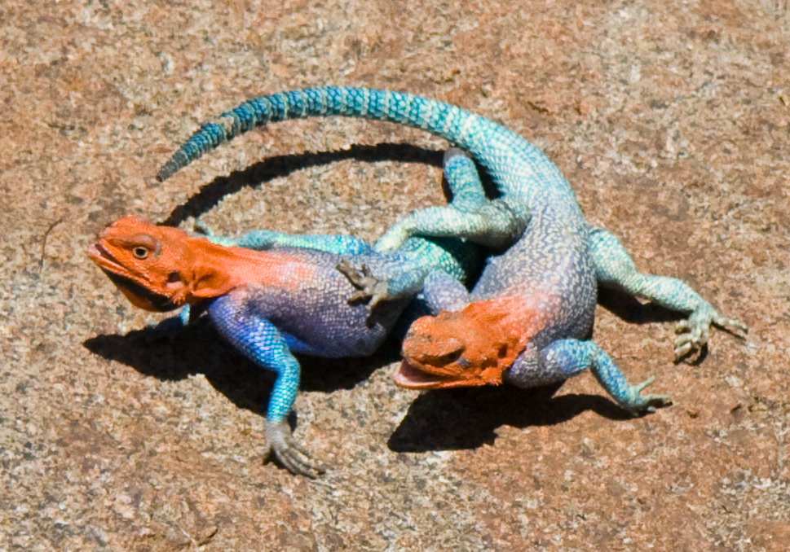
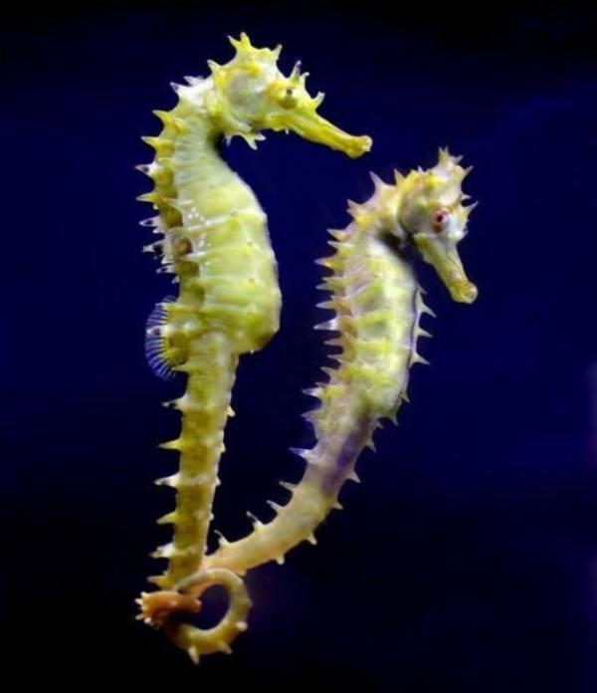
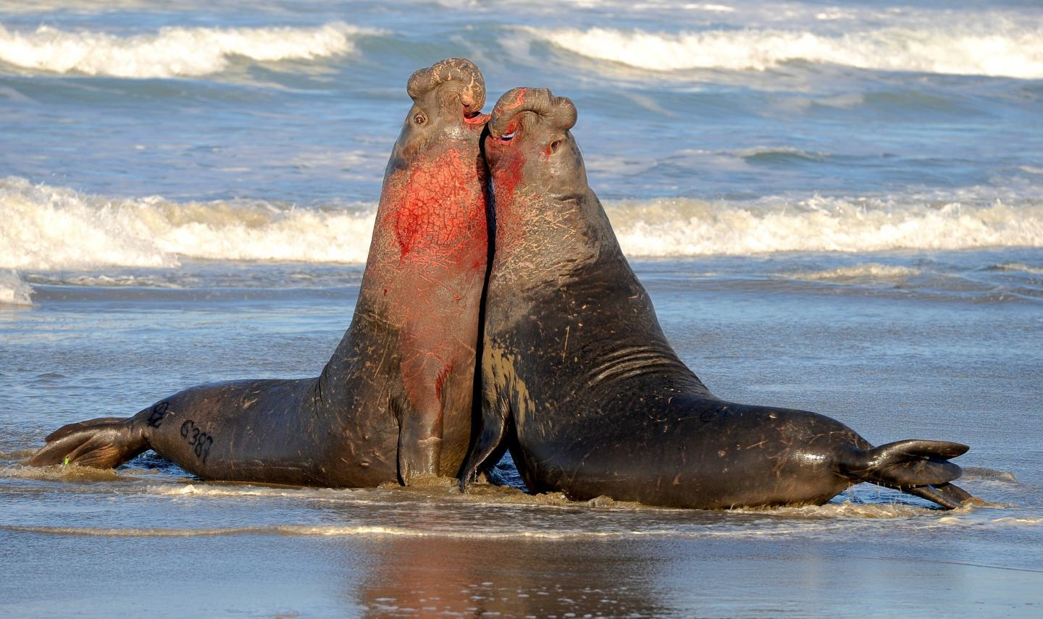
Optimization of Mouse Social Behavior Data Analyses Pipeline
Figure adapted with permission from Dr. Neunuebel

Slide 3
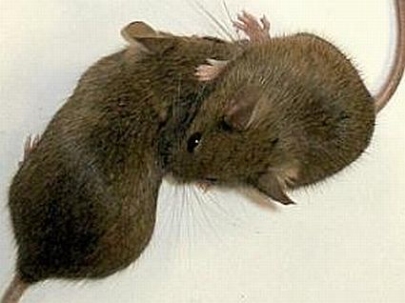
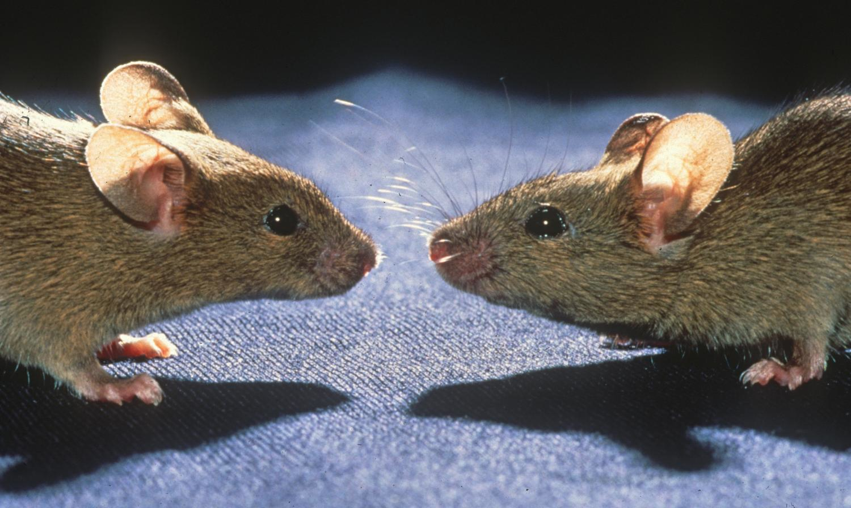
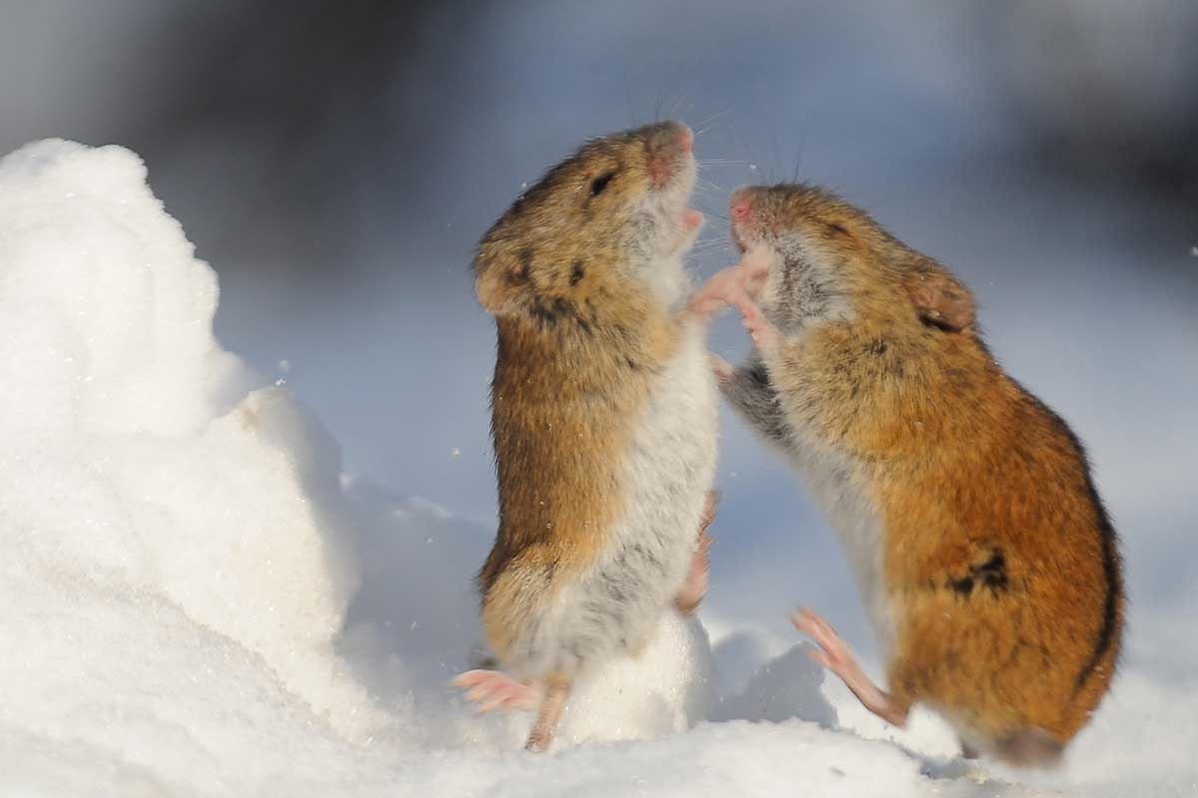
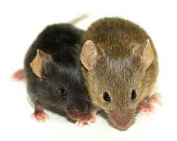
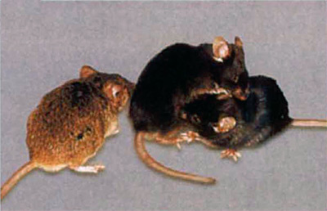
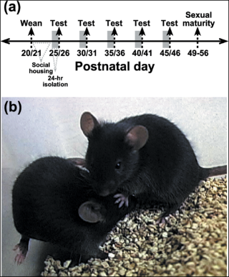
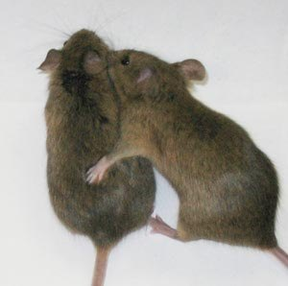
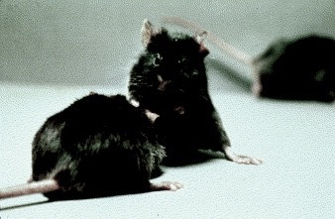
Optimization of Mouse Social Behavior Data Analyses Pipeline
Figure adapted with permission from Dr. Neunuebel

Slide 4
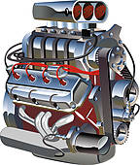
Optimization of Mouse Social Behavior Data Analyses Pipeline
Experiment
Download data
Audio
Video
Output
data
data
Audio
Video
MUSE
vocalizations
trajectories
which mouse vocalized
Upload data
Neunuebel Work Directory
run AX
run MOTR
run MUSE
Figure adapted with permission from Dr. Neunuebel

Slide 5
Optimization of Mouse Social Behavior Data Analyses Pipeline
Goals
Learn about the current system
Grid Engine job scheduler, suite of Matlab programs for analysis of mouse social behavior, and the scripts used to execute the programs
Transfer and optimize the pipeline to an upgraded cluster
Time
Functionality
Make this work helpful to the whole lab by documenting the workflow with details about the scripts and how to use the pipeline.

Slide 6
Optimization of Mouse Social Behavior Data Analyses Pipeline
Project Timeframe
12/14/20 - 3/14/21
Currently working on the first goal

Slide 7
Optimization of Mouse Social Behavior Data Analyses Pipeline
What I hope to learn
Cluster architecture and organization
Best practices for efficient and optimized job scheduling
Skills for handling the SLURM workload manager

Slide 8
Optimization of Mouse Social Behavior Data Analyses Pipeline
Goals for Next Month
Strong knowledge of both clusters - work efficiently in both
Transfer the pipeline piecewise, ensuring each step works on the new system
Validate correctness and optimize new pipeline

Slide 9
Thank you!

