Slide 1
Optimization of Mouse Social Behavior Data Analyses Pipeline
Student: Joel Turk, University of Delaware
Mentor: Anita Schwartz, University of Delaware
Researcher: Dr. Josh Neunuebel, University of Delaware
4/12/21

Slide 2
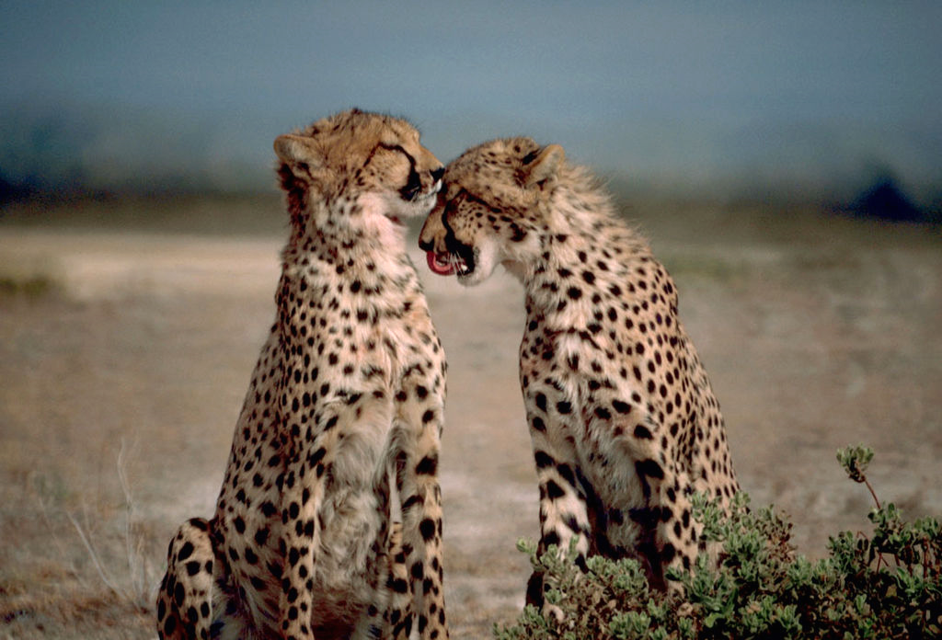
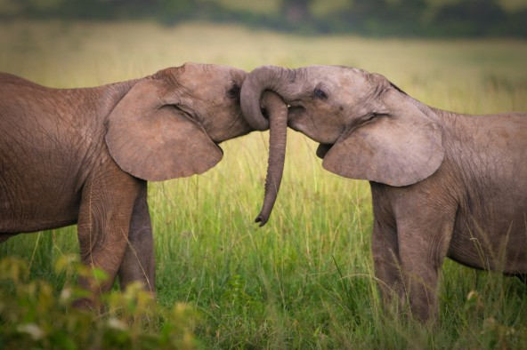
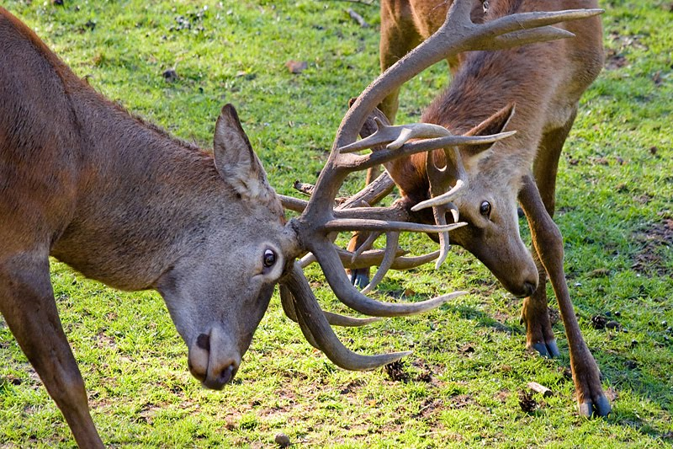
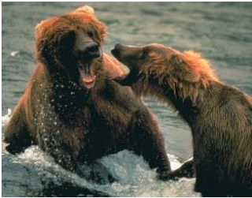
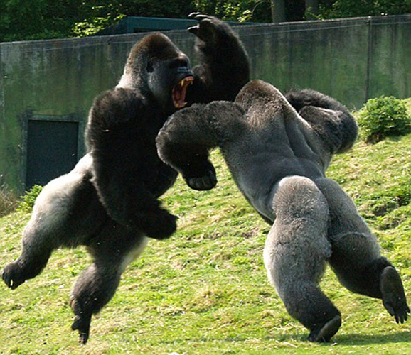
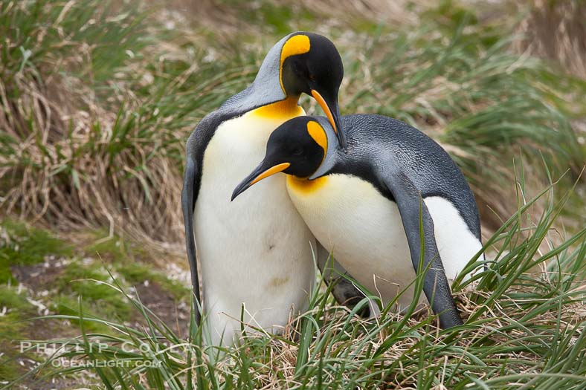
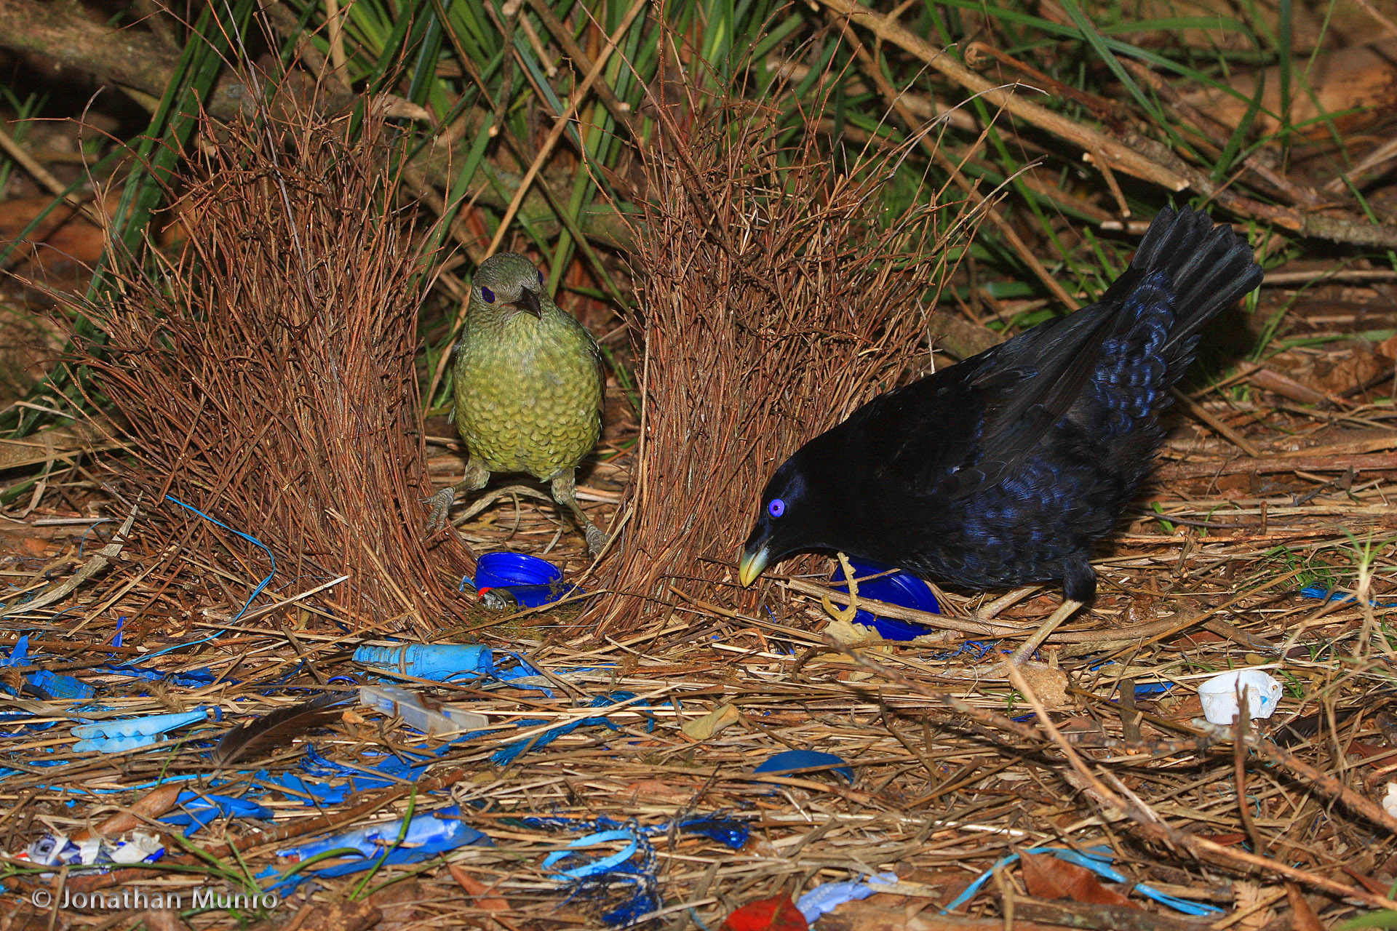
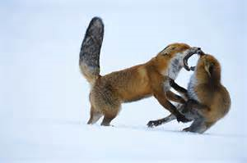
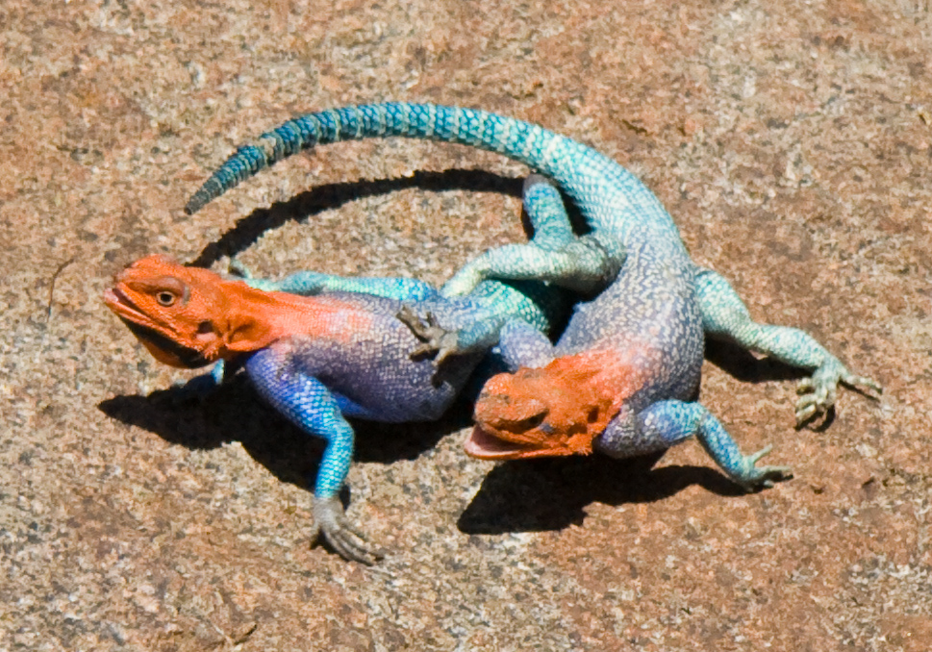
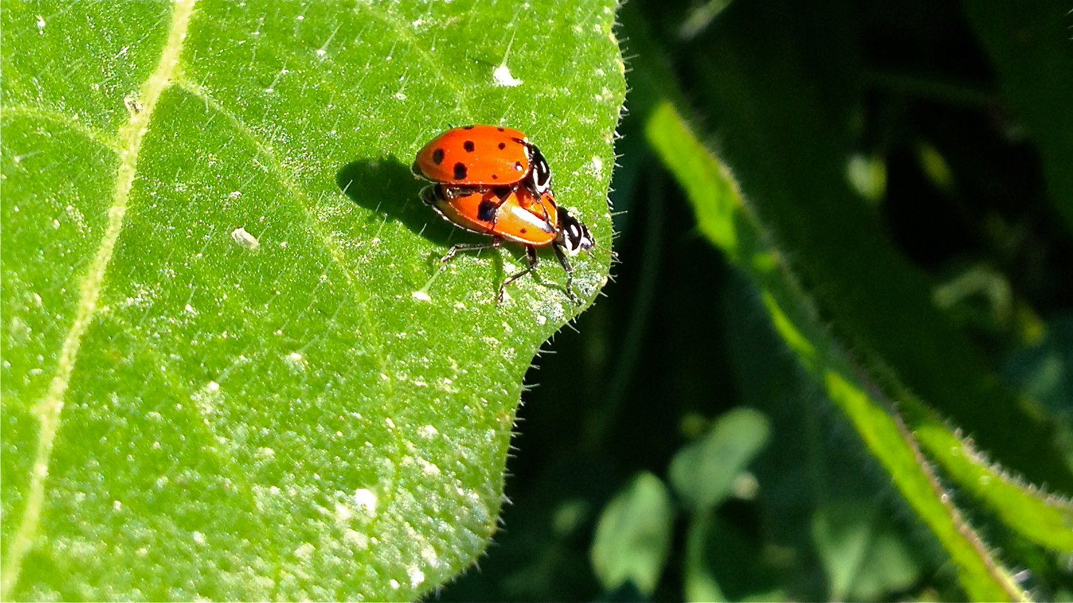
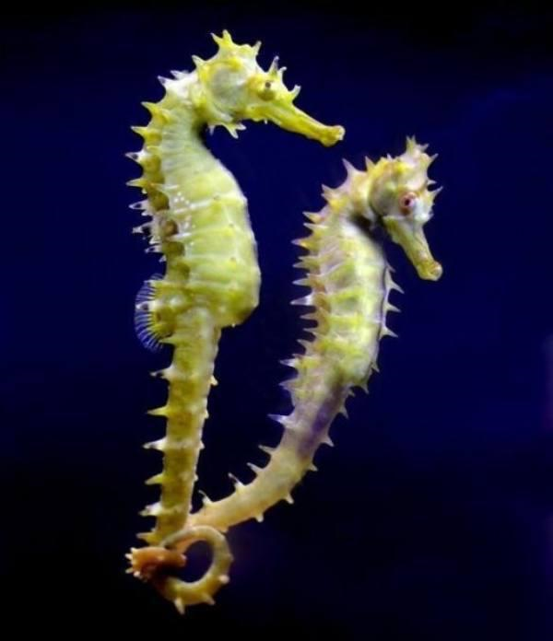
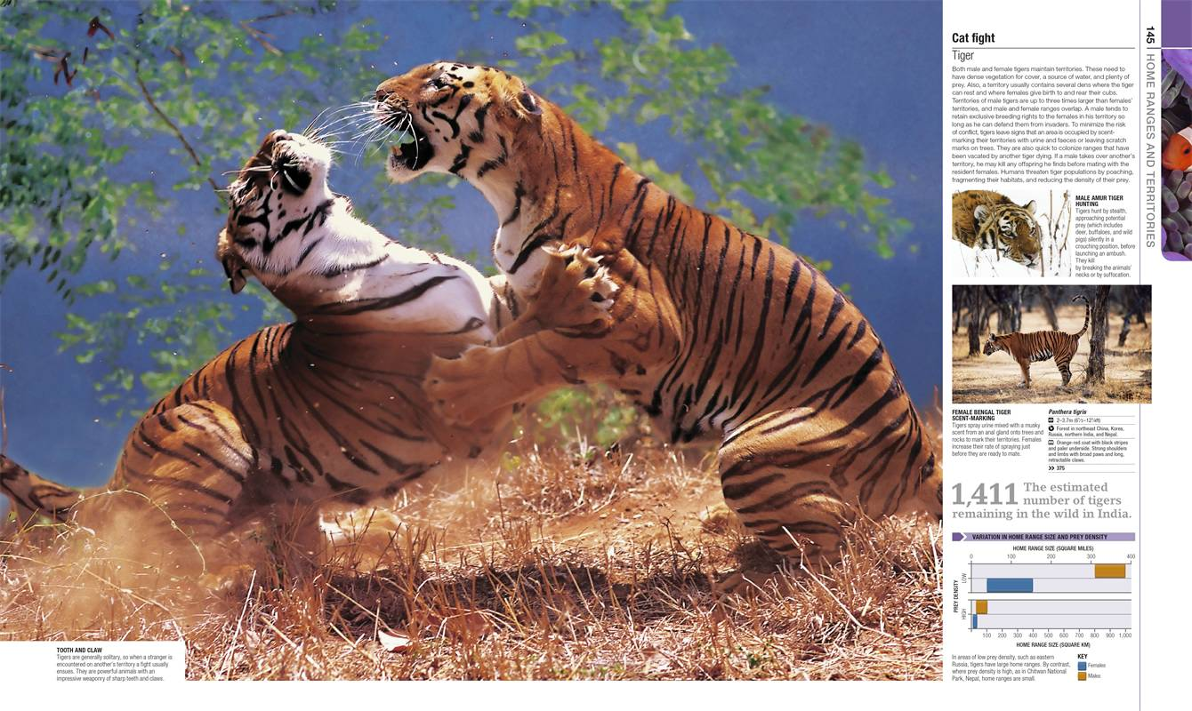
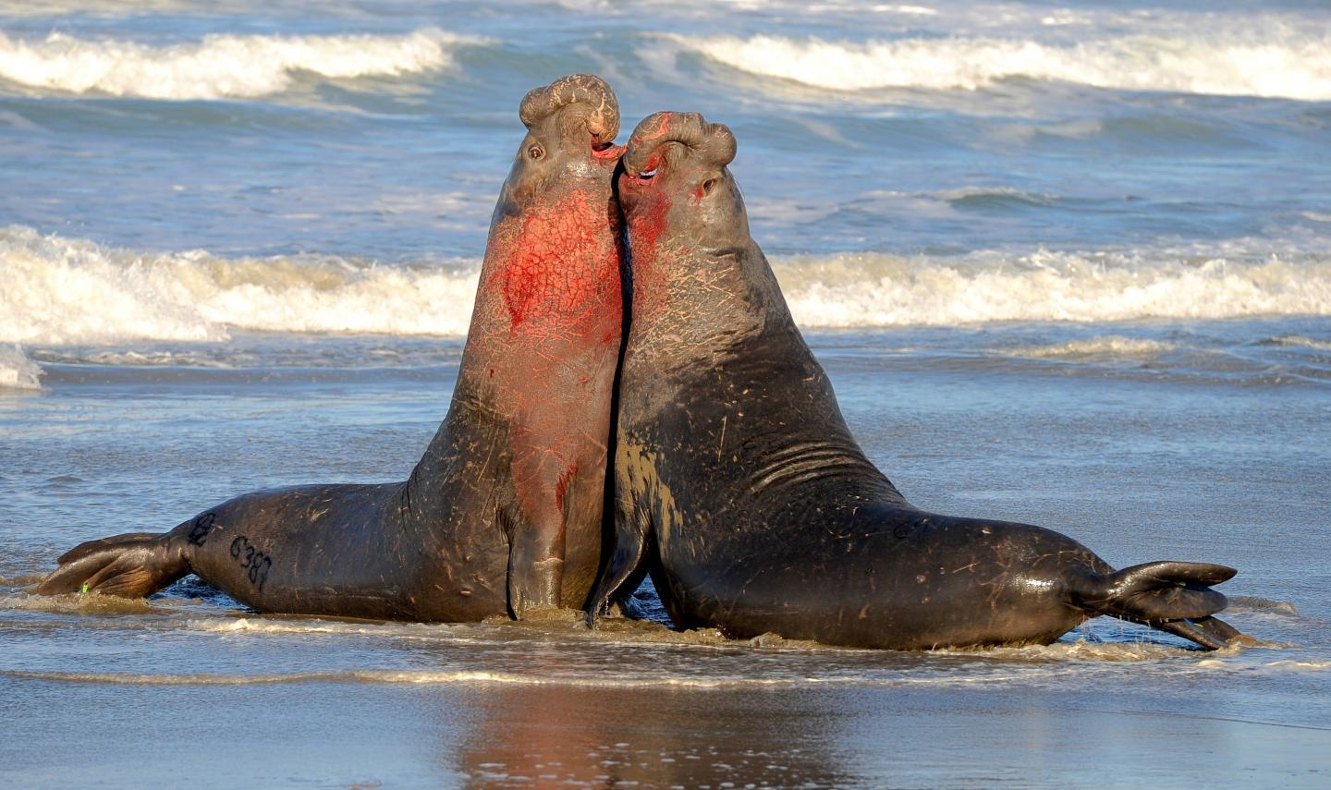

Optimization of Mouse Social Behavior Data Analyses Pipeline
Notes:
Animals are known to vocalize as a form of social communication
We know that these vocalizations have an effect on their social behaviors

Slide 3
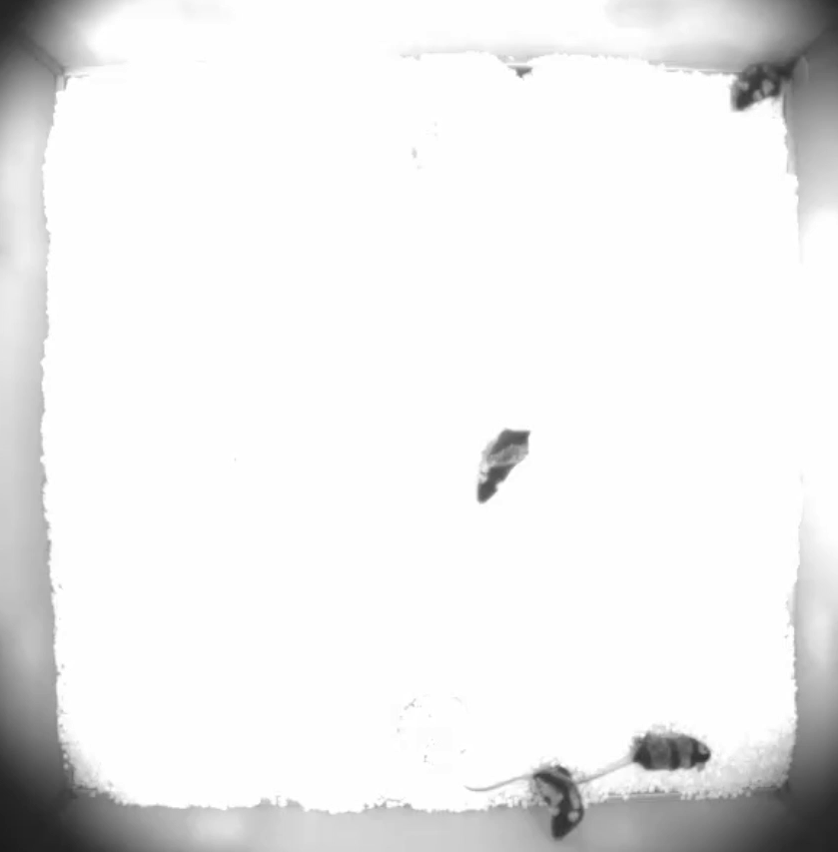
Optimization of Mouse Social Behavior Data Analyses Pipeline
Notes:
The Neunuebel Lab studies mice as a model organism and we look at the relationship between their vocalizations and behavior
We record LOTS of video and audio data, typically like what you see in this video
Dye mice uniquely to identify
We can track them and record their vocalizations
This is done on a cluster to be able to quickly analyze the data.
Old Cluster is Farber, We need new to transfer our data cluster – Caviness because Farber is shutting down sometime in the future

Slide 4
Optimization of Mouse Social Behavior Data Analyses Pipeline
Goals
  Learn about the Farber system
  Transfer and optimize the components of the data analysis pipeline to the Caviness cluster
  Document the workflow with details about the scripts and how to use the pipeline
Time frame
  12/14/20 through 4/14/21

Slide 5




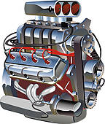
Farber Cluster
Experiment
Download data
Audio
Video
Output
data
data
Audio
Video
MUSE
vocalizations
trajectories
which mouse vocalized
Upload data
Neunuebel Work Directory
run AX
run MOTR
run MUSE
Notes:
Ax – parse vocaliztions from background noise in audio data
Motr – track individual mice movements
MUSE – Assign each vocalization to an animal

Slide 6


Caviness Cluster
Caviness
Loads MATLAB container via Singularity to run Motr
Upload experimental data
Train mouse tracking software
Submit Slurm job scripts
Modified to run with MCR
Generate Slurm job scripts
Download results
Notes:
Upload experimental data
Load MATLAB docker container via Singularity
Describe why we need the container
Replicates Farber OS and enable video decoding
how valet sets environment without .bash file
Within container, we can train the mouse tracking software, Motr
VNC GUI is much faster than the previously used X11 GUI
Generate scripts
Can’t submit scripts in container because of the slurm version
Submit scripts manually to complete the analysis
Download results to local machine

Slide 7
Optimization of Mouse Social Behavior Data Analyses Pipeline
What we accomplished
  Transferred and optimized mouse tracking software to work on the Caviness cluster
  Documented the workflow with details about the scripts and how to use the pipeline
    This enables others to use the software on Caviness
  Documented the obstacles of the project and their solution to aid in any future transfers of software to other high performance computing clusters
Notes:
Now using VNC server

Slide 8
Lessons Learned
Learned about Grid Engine and Slurm job schedulers
Specific details of tracking software functionality
Process of setting up data analyses on a cluster
  Running jobs, fitting software together, writing scripts used to execute the programs
Importance of documenting each step in the process
Learned how research facilitation works enabling me to mentor future students wanting help with the process

Slide 9
Contributions to Research
Computing Community
Github repository containing code and documentation for the project

Slide 10
Thank you!
CAREERS team
Anita Schwartz
Dr. Josh Neunuebel
HPC Systems Group
Rachel Clein
Christy Kawar
Yichong Andre Ma
Devashish Pande
Sarah Paige Werner

Slide 11
Questions?
Notes:
Add acknowledgements

